Slide 1
PROJECT-BASED LEARNING • DIGITAL LOGIC DESIGN
Design and Simulation of an Automatic Street Light Control System Using Combinational Logic Gates
A logic-gate based sensing and switching system that turns street lamps ON at dusk and OFF at dawn — without manual control.
PRESENTED BY
2620040081 Mohith
2620040083 Santhosh
2620040157 Jaideep
2620040178 Anudeepika
2620040179 Srivani
Department of Electronics & Communication Engineering

Slide 2
SESSION BRIEF
Aim, Objectives & Learning Outcomes
◎
✓
★
Aim
Instructional Objectives
Learning Outcomes
To design, simplify and simulate a combinational-logic circuit that automatically switches street lamps ON during darkness and OFF during daylight, replacing manual or timer-based control.
Identify sensor and control inputs of the system
Construct the truth table for the required behaviour
Derive and simplify the Boolean output expression
Realise the expression using basic logic gates
Build a gate-level combinational circuit from a specification
Simulate and verify circuit behaviour in Logisim
Justify the choice of gates and an alternate NAND-only design
02

Slide 3
INTRODUCTION
Why Automate the Street Light?
Conventional street lights are switched manually or by fixed timers. Both approaches waste energy on cloudy, rainy or early-dark days, and depend on a person remembering to act. A combinational-logic controller reacts directly to ambient light, so the response is instantaneous, consistent and needs no human intervention.
⚡
Why Combinational Logic?
Energy Wastage
Output depends only on present sensor state — no memory needed
Built from a handful of standard gate ICs — low cost, easy to test
Deterministic, instant switching with zero software or firmware
Easy to simulate and verify in Logisim before hardware build
Timer-based lamps often stay on well after sunrise, or switch late at dusk.
Manual Dependency
Human-operated switching is inconsistent and unreliable at scale.
No Weather Response
Fixed schedules ignore overcast days that darken earlier than usual.
03

Slide 4
SYSTEM DESIGN
System Block Diagram
LDR
Sensor
Comparator
Combinational
Logic Unit
Driver
Circuit
Street
Lamp
→
→
→
→
Senses ambient light intensity
Converts analog level → digital 0/1
NOT + AND gate network
Transistor / relay stage
Final ON/OFF load
Signal flow: light intensity is sensed continuously, digitised, evaluated by the logic unit, and the lamp responds within milliseconds.
Input A
Input B
Output Y
Comparator output — 1 = daylight, 0 = darkness
Manual enable / override switch — 1 = system active
Lamp drive signal — 1 = lamp ON, 0 = lamp OFF
04

Slide 5
OPERATION
Working Principle
1
2
3
4
Sense
Invert
Enable
Drive
The LDR's resistance rises as light falls; a comparator converts this analog change into a clean digital level A.
Since lamp-ON should occur when it is dark (A = 0), a NOT gate produces A′, which is HIGH only at night.
An AND gate combines A′ with the manual enable input B, so the system can be switched off for maintenance.
The AND-gate output Y switches a transistor/relay stage that energises the actual street lamp.
Day → Night Transition
As dusk falls, A drops from 1 to 0. With the system enabled (B = 1), A′ rises to 1 and the AND gate output Y follows it to 1 — the lamp turns ON automatically, with no digital memory or clock required.
05

Slide 6
BOOLEAN DESIGN
Inputs, Output & Truth Table
Signal Definitions
A | B | A′ | Y = A′·B | Meaning
1 | 1 | 0 | 0 | Day, enabled → OFF
1 | 0 | 0 | 0 | Day, disabled → OFF
0 | 1 | 1 | 1 | Night, enabled → ON
0 | 0 | 1 | 0 | Night, disabled → OFF
A
Light-sensor (comparator) output — 1 = daylight, 0 = dark
B
Manual enable / override switch — 1 = enabled
Y
Lamp control output — 1 = lamp ON, 0 = lamp OFF
Y = A′ · B
is a minimal, two-gate expression; the same behaviour is realised in hardware using one NOT gate and one AND gate.
06

Slide 7
BOOLEAN DESIGN
Deriving the Switching Expression
Sum-of-Products from the Truth Table
Y is 1 for exactly one input row (A = 0, B = 1). Reading that row directly gives the sum-of-products form, which is already in its simplest shape — a single product term, so no Boolean-law reduction or K-map grouping is needed.
Y = Ā · B
Y = NOT(A) · B (gate-level reading)
Universal-Gate Equivalent (NAND-only)
Y = [(A↑A)↑B] ↑ [(A↑A)↑B]
where ↑ denotes the NAND operation
2-Variable Map
 | B=0 | B=1
A=0 | 0 | 1
A=1 | 0 | 0
Only one cell is 1 — there is nothing left to group, confirming Y = A′B is minimal.
07

Slide 8
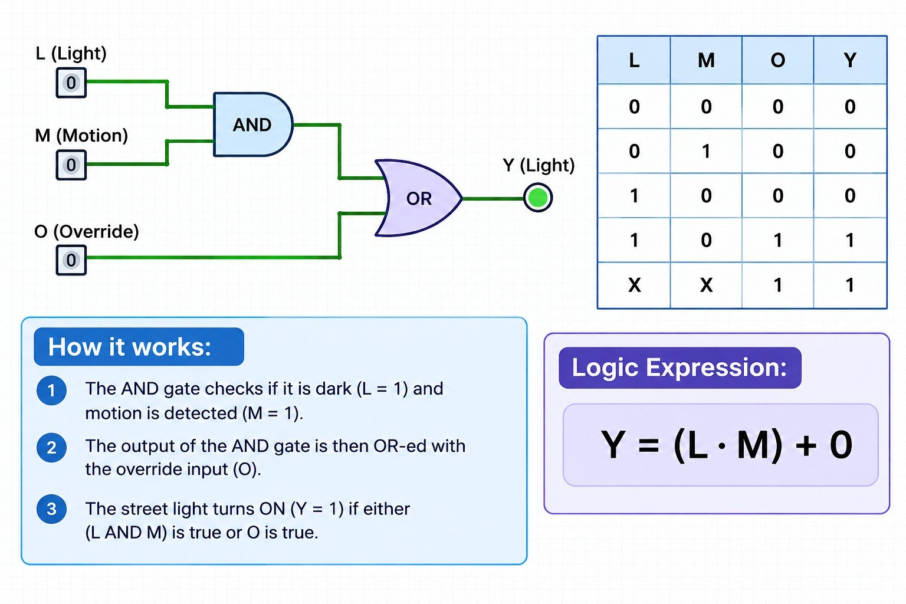
CIRCUIT REALISATION
Gate-Level Schematic (Logisim Layout)
08

Slide 9
ALTERNATE DESIGN
Universal-Gate Realisation — NAND Only
Why Build It This Way?
LOGISIM – NAND_ONLY.CIRC
A′
NAND is a universal gate — any Boolean function, including our AND–NOT circuit, can be built from NAND gates alone.
Manufacturers stock NAND ICs (e.g. 7400) in bulk, often making a NAND-only board cheaper and easier to source.
Using one gate family simplifies PCB layout, testing, and spares inventory for the project.
G1 (NOT)
A
G2
NAND(A′,B)
G3 (NOT)
Y
B
Y = [(A↑A)↑B] ↑ [(A↑A)↑B]
G1 and G3 are NAND gates with tied inputs — each behaves as a plain inverter (NOT). G2 performs the AND once its output is re-inverted by G3.
10

Slide 10
IMPLEMENTATION
Components Required
1
LDR
6
BC547 Transistor
Light-dependent resistor — senses ambient brightness
Switching device that drives the relay from the logic output
2
LM358 / LM339
7
5V Relay Module
Comparator IC — converts LDR voltage to a clean digital level
Isolates and switches the mains-connected lamp load
3
IC 7404
8
LED / Lamp
Hex NOT (inverter) gate package
Load representing the street light
4
IC 7408
9
Resistors & Preset
Quad 2-input AND gate package
Bias the LDR divider and set the comparator threshold
5
IC 7400
10
Regulated 5V Supply
Quad 2-input NAND gate — used in the universal-gate design
Powers the sensor, comparator and logic ICs
11

Slide 11
BENEFITS
Advantages of the System
✦
✦
✦
Energy Efficient
Fully Automatic
Low Cost
Lamps burn only during actual darkness, cutting wasted daytime and early-dusk power draw.
No human operator, scheduling, or app is needed — the circuit self-triggers on light level.
Built from a handful of standard gate ICs, a comparator and an LDR — inexpensive to build and repair.
✦
✦
✦
Fast & Reliable
Weather-Responsive
Easily Extendable
Purely combinational logic responds within microseconds and has no software to crash or hang.
Reacts to real ambient darkness, so overcast days trigger the lamp earlier automatically.
The same gate stage can add motion sensors, dimming, or IoT monitoring later.
12

Slide 12
IMPACT
Applications & Future Scope
Where This Circuit Applies Today
Future Scope
Municipal street and highway lighting
Garden, campus and parking-lot lamps
Staircase and corridor lighting in buildings
Solar-powered lanterns in remote areas
Signboard and billboard illumination
Add a PIR motion sensor and OR-gate stage for on-demand brightening
Introduce sequential logic (counters/timers) for scheduled dimming
Interface with a microcontroller for IoT-based remote monitoring
Combine with solar charging for fully off-grid operation
Use pulse-width control for gradual dawn/dusk brightness fading
13

Slide 13
CLOSING
Conclusion
The Automatic Street Light Control System demonstrates how a truth table, a minimal Boolean expression, and just two or three logic gates can replace manual switching entirely. Simulated and verified in Logisim, the design is simple, low-cost, energy-efficient, and readily extendable with sensors, timers, or IoT modules for smarter city lighting.
Two-gate core (NOT + AND) meets the full specification
Verified functionally correct across all input combinations
NAND-only version confirms the universal-gate property
References
M. Morris Mano, Digital Design, Pearson Education.
Logisim Evolution documentation — logisim-evolution.github.io
Texas Instruments, 74-series Logic Gate datasheets (7400, 7404, 7408).
Thank You

